Slide 1
HIGH-ORDER COMPONENTS
Alexandra Krause
CUS 1172

Slide 2
What is it?
A higher-order component (HOC) is an advanced technique in React for reusing component logic. In other words it takes a component and returns a new one.
It is said to be an advanced technique in a react.js function for reusing component logic
HOC is one of the best known principles of software development

Slide 3
HOC Function Examples
01
02
03
04
.forEach()
.map()
.reduce()
.filter()
Iterates over every element in an array w/ the same code
Transforms an array by applying a func. To all of its elements
Executes a provided func. For each value of the array
checks every element in an array if it meets certain requirements

Slide 4
HOC Facts
Pure function
Clean up a component and remove and separate handlers,
Separation for concern
Enhancement on different components
Wrap multiple components in your code

Slide 5
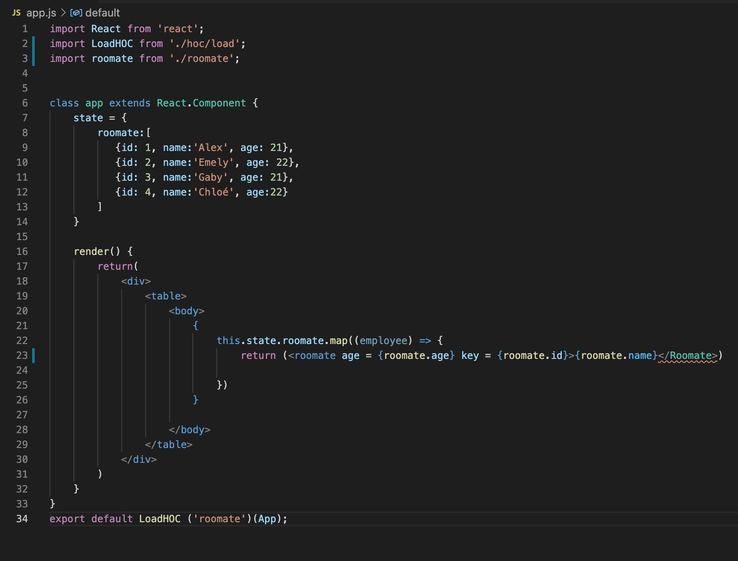
Code Screenshots

Slide 6
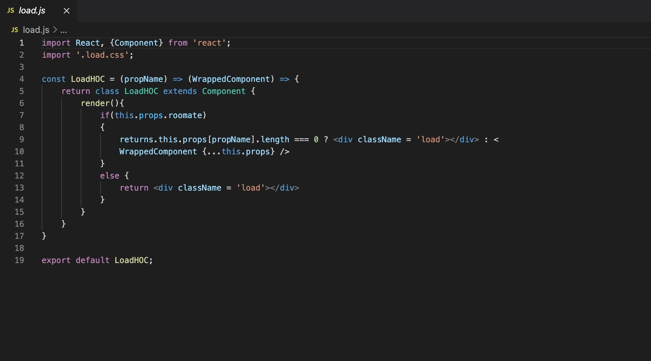



CONT.

Slide 7
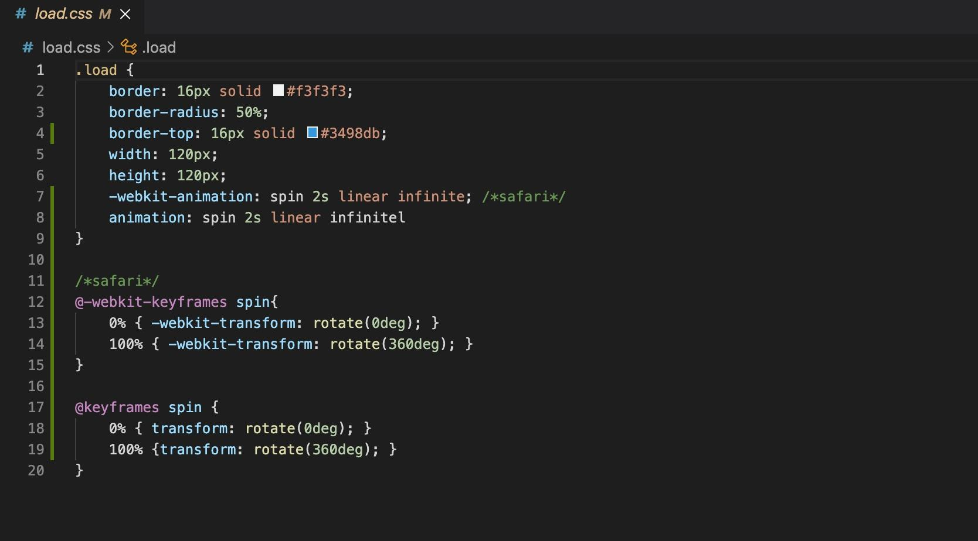
CONT.

Slide 8
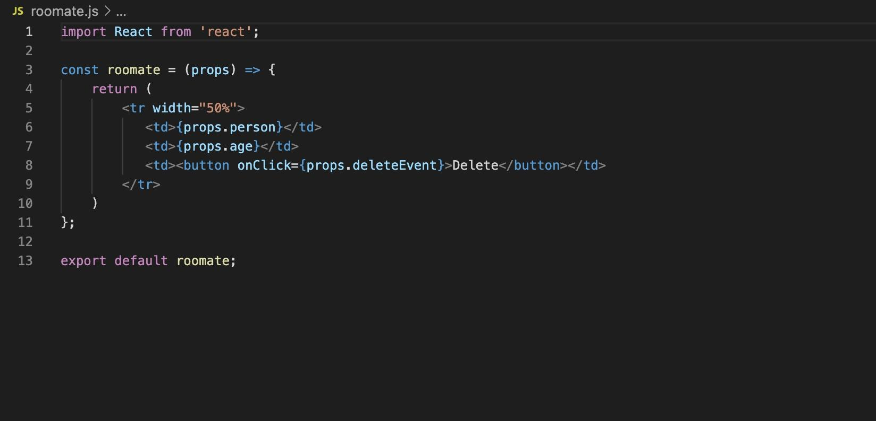
CONT.

Slide 9
Demo:
It is supposed to return:
Alex 21 deletebutton
Emely 22 deletebutton
Gaby 21 deletebutton
chloe 22 deletebutton

